Slide 1
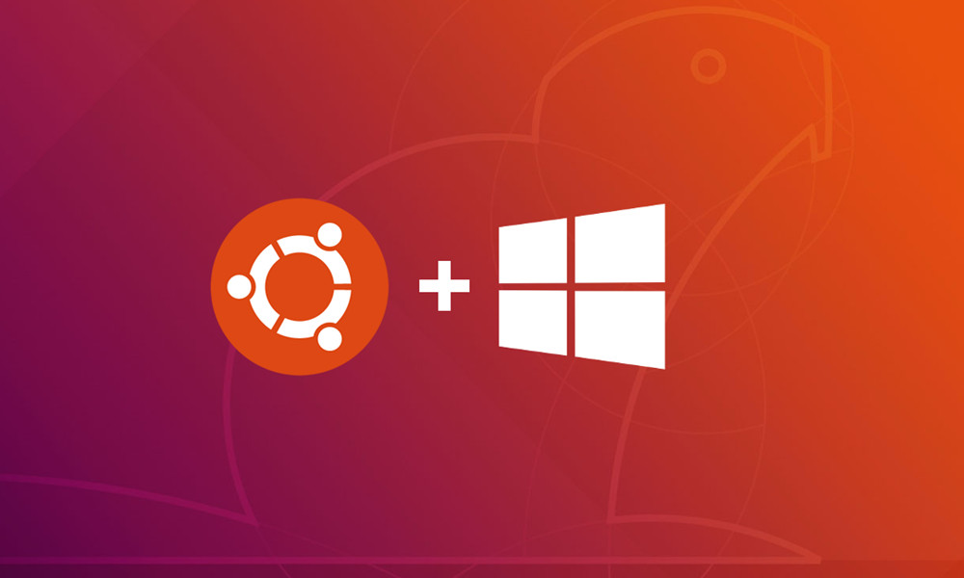
Setting up Ubuntu on Windows

Slide 2

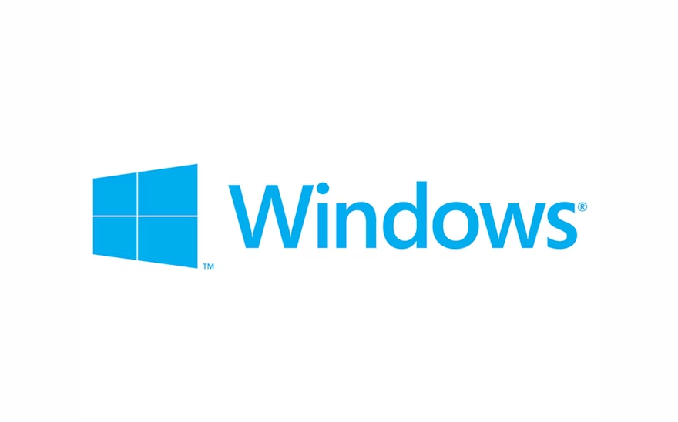

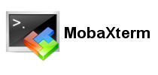

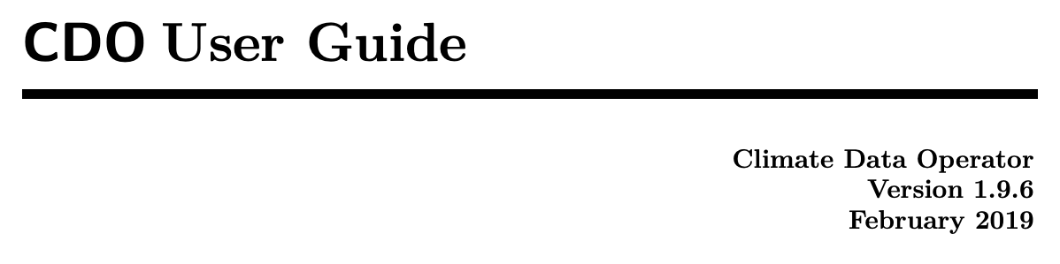
What you Need

Slide 3
Step by Step Guide
Setting up the Environment
PC have at least 4GB of RAM.
Turn on Windows Virtualization.
Install the necessary application.

Slide 4
Setting up the Environment
System Requirement
For a better experiences handling a big data, it is preferable to have a RAM of 8GB but the minimum requirement is 4GB.
There are many ways to handle to setup the environment such as directly using Linux, Windows and Mac.
For this tutorial, we will be using Windows as a base (since it is the most popular) but use Linux as the Operating System in a Virtual Machine.
What is a Virtual Machine?
A Virtual Machine is a software-based emulation of a physical computer, enabling multiple operating systems to run on a single physical machine simultaneously.
In this case, we are using Linux emulated inside our Windows machine because the program Climate Data Operator (CDO) are highly supported by Linux OS.

Slide 5
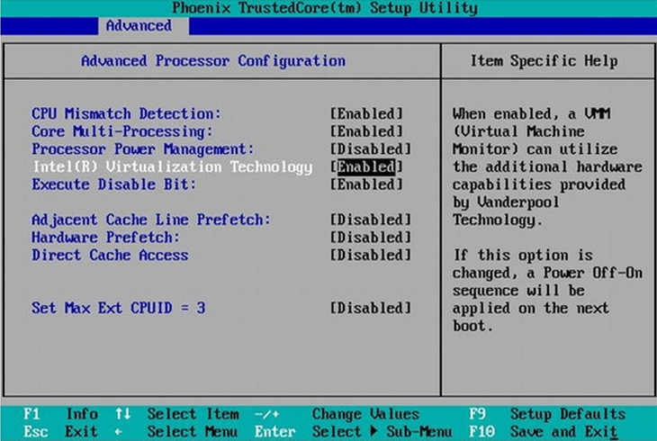
Turn on Windows Virtualization Technology
Make sure the Virtualization is enabled. It can be checked in BIOS.
Depending on your laptop manufacturer, as you turn on your PC/Laptop, mash repeatedly of either F1, F2, F10, F12, Del, or Esc. You can google the exact key first beforehand.
You navigate through the BIOS using directional key, select item using “Enter” and Save and Exit using “F10”. (Some BIOS may have a different navigation key).
Go to the Advanced Tab and Turn on Virtualization Technology.
As a note: Most PC using Windows 10/11 have their Virtualization “Enabled” as Default.
You can skip part 4 as most laptop/pc have its Virtualization Turned on by default.

Slide 6
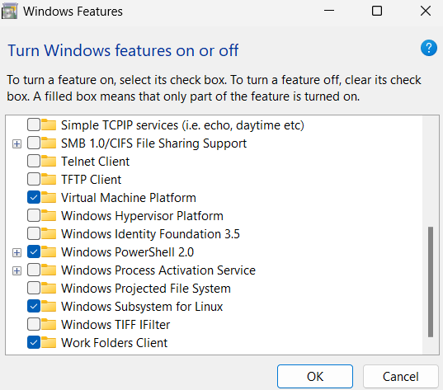
Turn on Windows Virtual Machine Platform
Select your Computer Search Bar and type: “Turn Windows Feature On and Off”.
In the Windows Features window that just opened,
find Virtual Machine Platform and select it.
find Windows Subsystem for Linux and select it.
Select OK. You need to restart your PC.
Windows Virtualization Done!!!

Slide 7
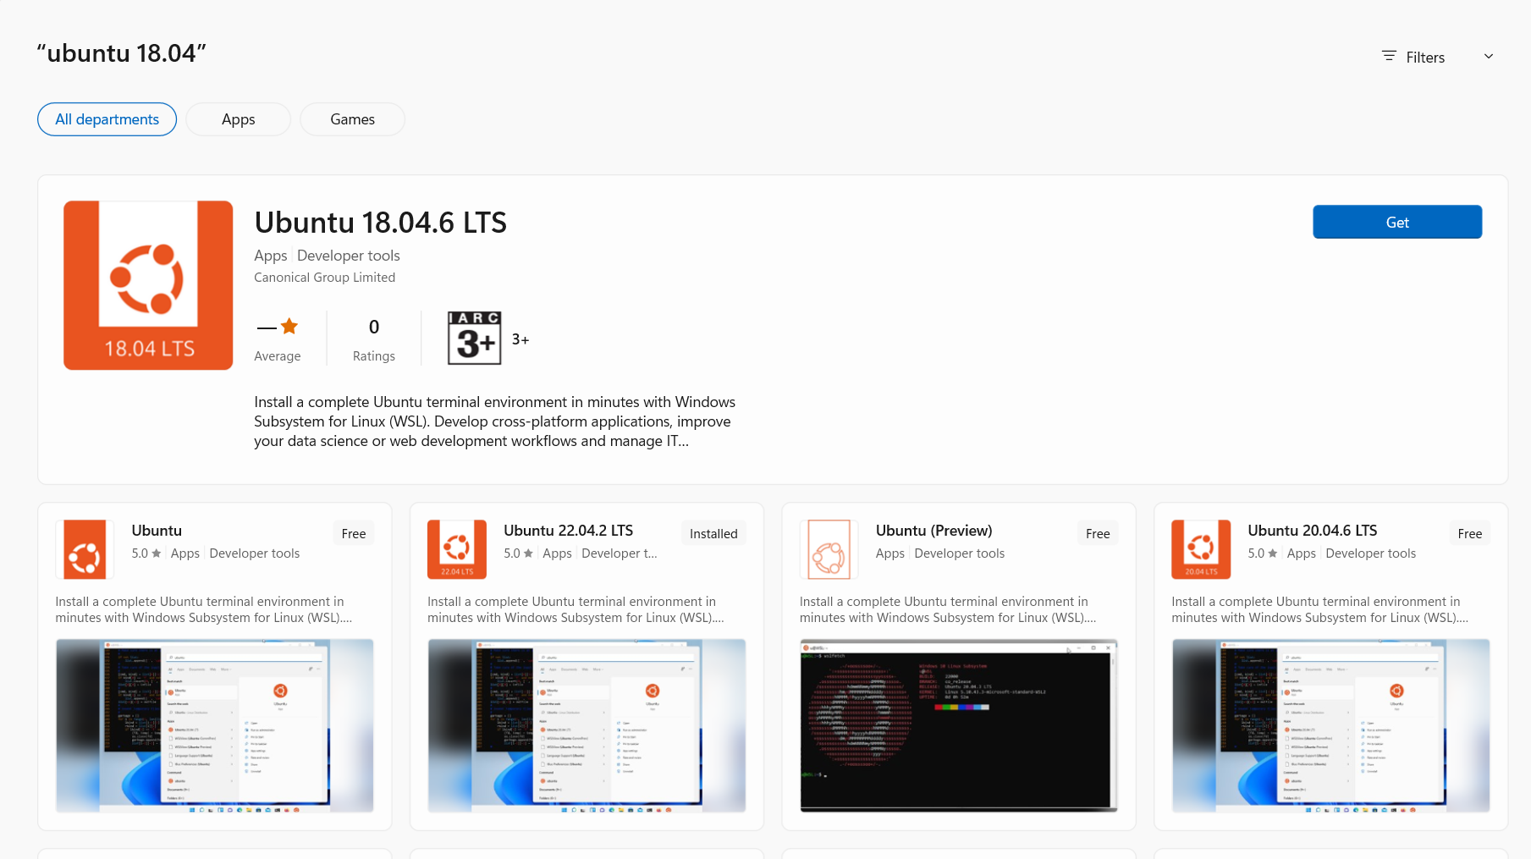
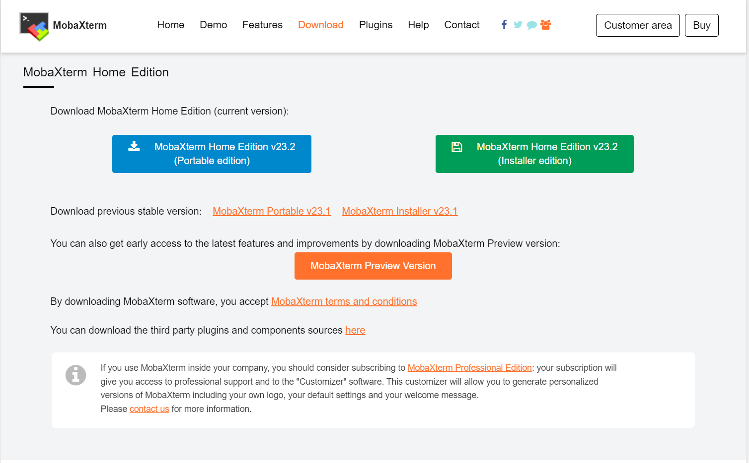
Download Ubuntu in your Windows.
Select your Computer Search Bar and type: “Microsoft Store”
In the Microsoft Store Search Bar, type: “ubuntu 18.04”.
Install by clicking the “Get” Button.
After successful installation, you will be prompted to create your Username and Password.
Download MobaXterm to use Virtual Machine.
The Virtual Machine that we are going to use are MobaXterm.
It is light, user friendly and easy to use.
Link to Download: https://mobaxterm.mobatek.net/download-home-edition.html
You can download the Portable version.
Run the Downloaded Program to start the program.

Slide 8
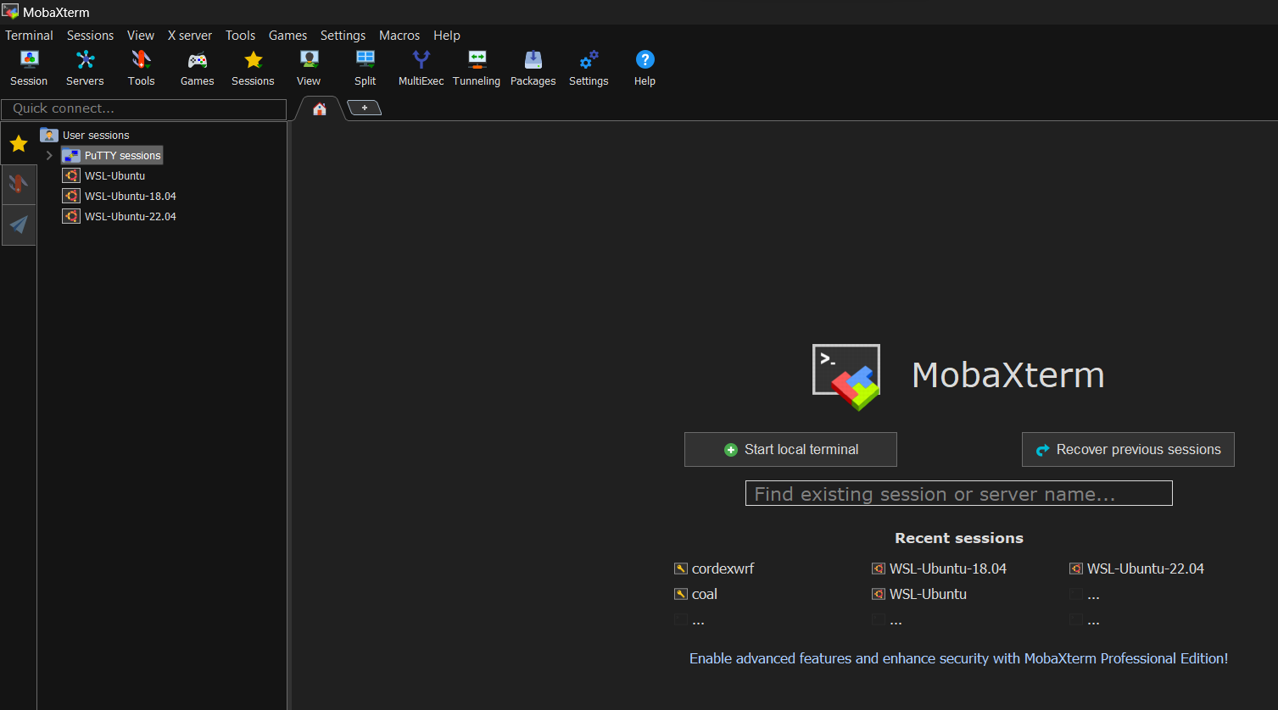
After both Ubuntu and MobaXterm installation are done. You can click on your desktop Icon (MobaXterm) to open the application.
Inside, you will be able to use WPS-Ubuntu that you have downloaded by clicking the shortcut on the left.
Installation Done!!!
It have multitude of uses, explore at your own leisure.

Slide 9
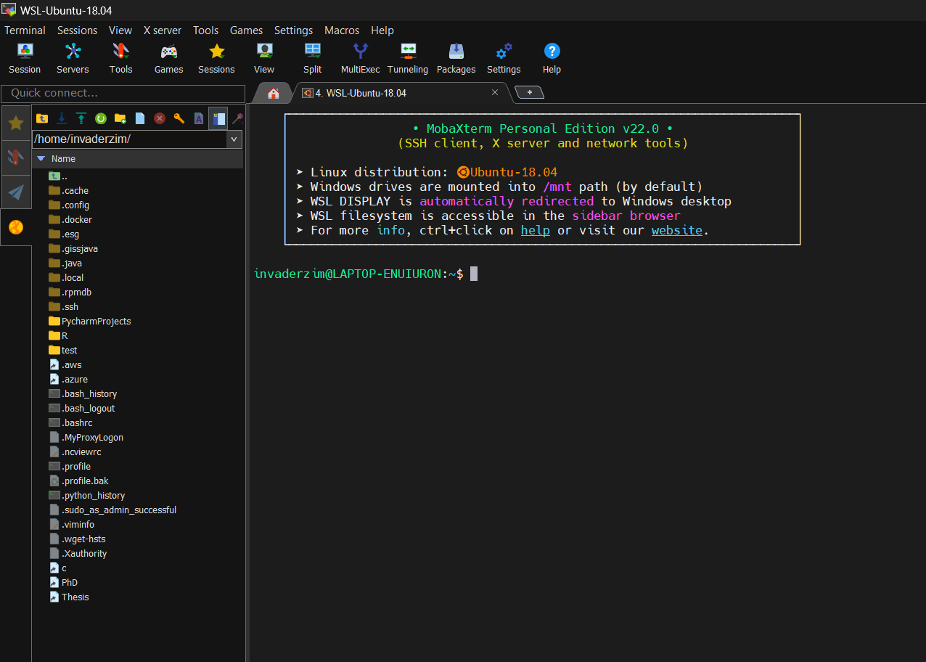
This will show you which Linux distribution you are using

Slide 10
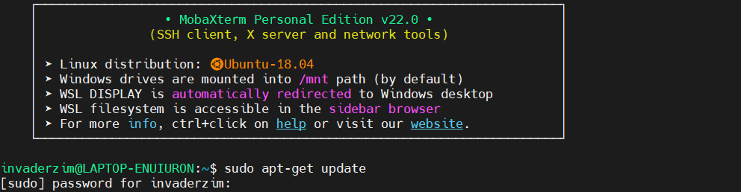
Downloading CDO
There are many ways to download CDO but one of the easiest way is to type in the terminal:
sudo apt-get update
Press Enter and you will be asked to enter your password. (As you type your password, it will not show you anything, that’s normal. Press Enter after you type your password.
Wait for the update to be done

Slide 11
Then, type:
sudo apt-get install cdo
Press Enter and CDO installation will commences.
sudo is linux version of super user (run as administrator in windows), it is required to do certain activities that require permission. You will be prompted to enter your password afterwards.
apt-get is a command-line tool that helps in handling packages in Linux. Its main task is to retrieve the information and packages from the authenticated sources for installation, upgrade, and removal of packages.
Update is to make sure your current package in linux is up-to-date. So, we type in that first, you will have to wait for a bit for the installation to be done.
Install is a command to install, in this case we want to install cdo. After typing the command, download will commences.
Other package to install:
sudo apt-get install ncview
sudo apt-get install grads
sudo apt-get install netcdf-bin
sudo apt-get install gdal-bin
That’s it for now, we will learn more about both Linux and CDO more in depth later. Congratulation on the Successful Installation!! If there’s a problem, we can revisit this part again.

